Slide 1
Chapter 1

Slide 2
Objectives

Slide 3
Objectives (cont.)

Slide 4
Four general-purpose programming languages

Slide 5
The Python timeline

Slide 6
Syntax differences between Python and Java

Slide 7
Why Python is a great first language

Slide 8
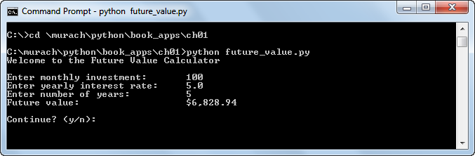
A console application

Slide 9
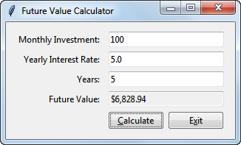
A GUI application

Slide 10
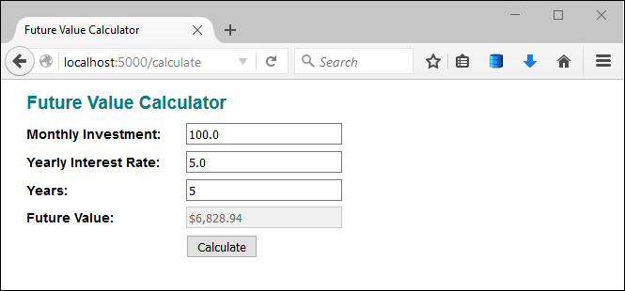
A web application

Slide 11
The source code for a console application

Slide 12
The source code for a console application (cont.)

Slide 13
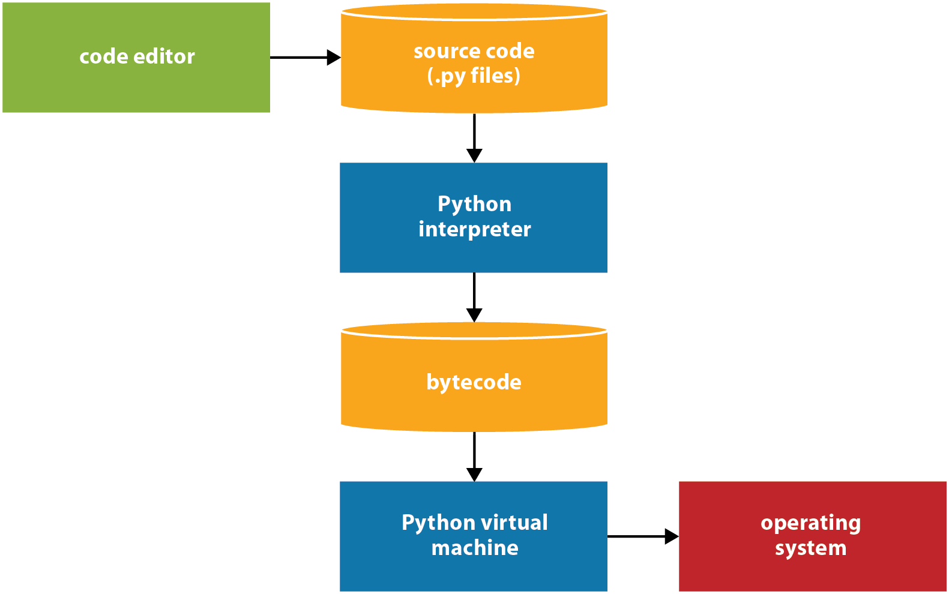
How Python compiles and runs source code

Slide 14
Procedure

Slide 15
Main memory and disk storage as an application runs

Slide 16
How disk storage and main memory work together

Slide 17
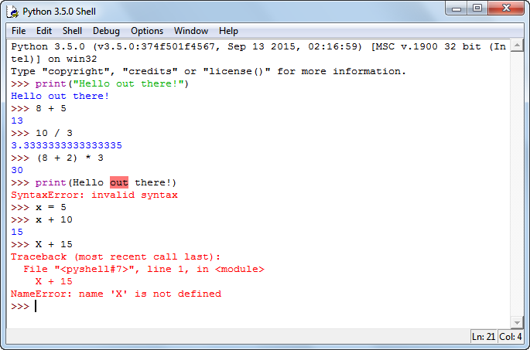
IDLE’s interactive shell

Slide 18
How to open, close, and restart the shell

Slide 19
How to use the interactive shell

Slide 20
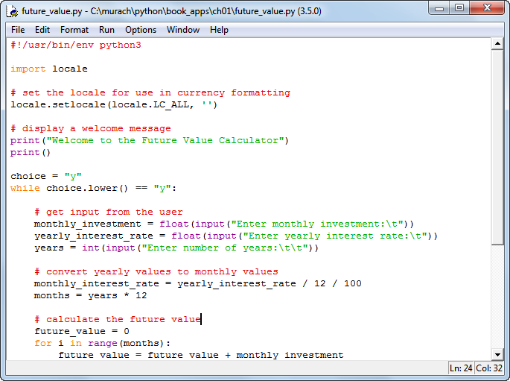
IDLE’s editor with a source file displayed

Slide 21
How to create, open, save, and close source files

Slide 22

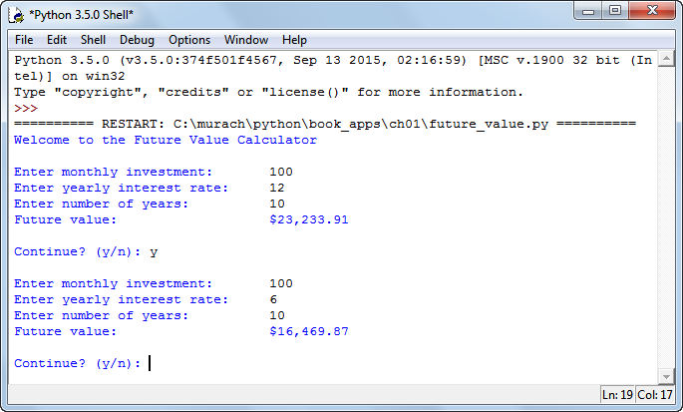
A console application that’s being run in the shell

Slide 23
How to compile and run a Python program

Slide 24
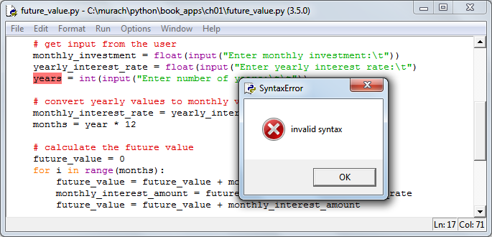
A dialog box for a syntax error

Slide 25
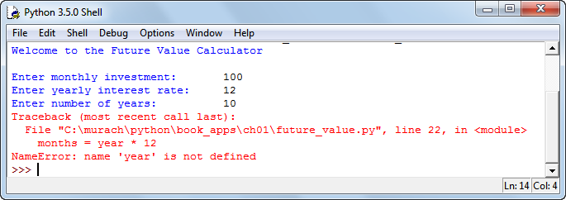
A message that’s displayed for a runtime error

